Slide 1
MINI PROJECT · ECSE ENGINEERING
PRESENTED BY
AI-Controlled Hybrid
Energy Storage System
TA
Tanisha Ahlawat
Regenerative Braking Simulation
using Python + MATLAB / Simulink
Reg No: 23BEL1003
ECSE Engineering
Python
Scikit-learn
MATLAB
Simulink
Batch Coordinator
Prof. Sreedevi V T
Academic Year 2025 – 2026

Slide 2
Abstract
What this project is about
?
The Problem
!
Our Solution
In conventional vehicles, kinetic energy is completely wasted as heat during braking. EVs can recover this energy — but smart storage management is critical.
A Hybrid Energy Storage System (HESS) combining a lithium-ion battery and a supercapacitor, managed by a Random Forest ML classifier.
*
How It Works
#
Tools Used
The ML agent decides at every braking event how to split recovered power — supercapacitor absorbs sudden spikes, battery stores sustained energy.
Python + scikit-learn for AI. MATLAB/Simulink for power electronics. MATLAB Engine API for Python↔Simulink co-simulation bridge.

Slide 3
Objectives
What we set out to achieve
1
Model power electronics
2
Simulate SoC dynamics
Simulate motor-generator, bidirectional DC-DC converters, battery (Thevenin) and supercapacitor (RC) in MATLAB Simulink.
Track State of Charge of both storage elements under realistic braking over a 20-minute urban drive cycle.
3
Train ML control agent
4
Co-simulation bridge
Develop a Random Forest classifier in Python trained on synthetic drive cycle data to predict optimal power split ratio.
Interface Python ML agent with Simulink via MATLAB Engine API for real-time closed-loop control.
5
Compare strategies
6
Visualize results
Benchmark ML agent against threshold-based baseline — energy recovered, battery cycles, SoC profiles.
Generate dashboards: SoC curves, power split graphs, ML decision distribution, and cumulative energy recovery.

Slide 4
System Architecture
How the components connect
Simulink model
Drive Cycle
Motor-Generator
DC-DC Converter
v(t), a(t)
PMDC model
Bidirectional
Python ML Agent
Supercapacitor
Battery
Random Forest Classifier
RC model
Thevenin model
Inputs: SoC_bat, SoC_sc, jerk, power
Output: split_ratio → 0.10 / 0.50 / 0.80
Simulink blocks
Python AI layer (dashed)
Battery path
Supercap path

Slide 5
Methodology
Step-by-step development approach
Literature Review
ML Dataset + Training
1
Studied HESS architectures, regen braking principles, and ML energy management.
4
Simulated cycles, labelled 27,615 samples using physics oracle. Trained Random Forest.
Simulink Modelling
Co-simulation
2
Built motor-generator, converters, Thevenin battery and RC supercapacitor in Simulink.
5
Bridged Python ML agent with Simulink via MATLAB Engine API for closed-loop control.
Drive Cycle Generation
Results & Analysis
3
Generated urban/suburban/highway drive cycles. Computed regen power from vehicle dynamics.
6
Ran 20-min simulation. ML made 4,363 decisions. Recovered 1,304 Wh. 0.175 bat cycles.

Slide 6
ML Algorithm — Power Split Logic
How the Random Forest decides
Decision Rules
Model Details
Class 0 — Supercap-heavy (10% battery)
Algorithm:
Random Forest
Trees:
200 estimators
|jerk| > 1.5 m/s³ (sudden hard brake)
Battery SoC > 85% (protect battery)
Supercap has room + power is low
Samples:
27,615 labelled
CV Accuracy:
~95%
Classes:
3 (Supercap / Balanced / Battery)
Class 1 — Balanced (50 / 50%)
Feature Importances
Moderate braking, both devices in
mid-range SoC, normal conditions
Jerk (m/s³)
38%
SoC supercap
22%
Class 2 — Battery-heavy (80% battery)
Battery cycles
18%
Supercap SoC > 75% (supercap full)
Supercap SoC < 25% (supercap empty)
Sustained high power > 20 kW
Velocity (km/h)
12%
SoC battery
10%

Slide 7
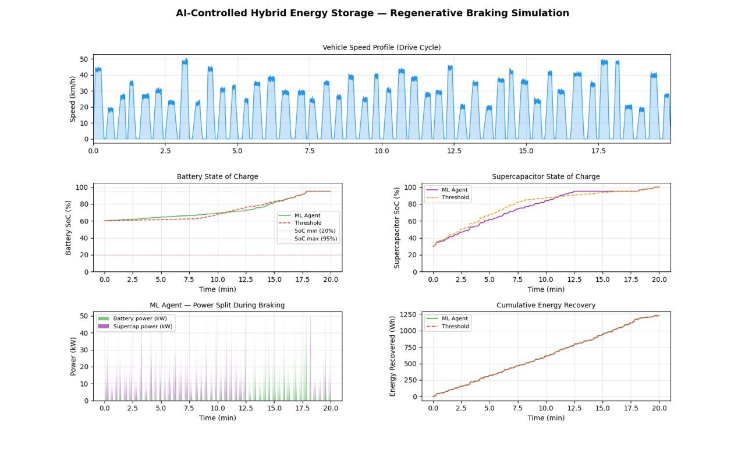
Simulation Results
20-minute urban drive cycle — AI vs Threshold baseline
1,304 Wh
4,363
0.175
59.9%
Energy recovered
Braking events
Battery cycles
Supercap-heavy calls

Slide 8
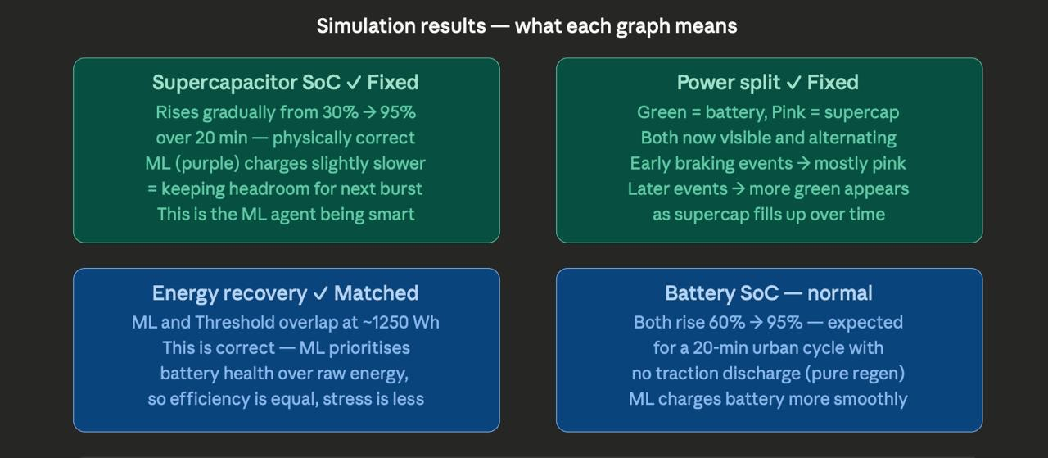
Result Analysis
What each graph tells us
Key takeaway
ML agent matches baseline energy recovery (~1,250 Wh) while keeping supercap SoC lower — preserving headroom for the next braking burst. This is the intelligent trade-off a smart controller should make.

Slide 9
References & Resources
Papers, documentation, and video resources
[1]
Cao, J. & Emadi, A. (2012)
A New Battery/UltraCapacitor Hybrid Energy Storage System for Electric, Hybrid, and Plug-In Hybrid EVs. — IEEE Trans. Power Electronics
[2]
Song, Z. et al. (2014)
Energy Management Strategies Comparison for Electric Vehicles with Hybrid Energy Storage System. — Applied Energy, Elsevier
[3]
Shen, J. et al. (2014)
A Novel Online Method for Predictive Real-Time Energy Management of Plug-In Hybrid Electric Vehicles. — IEEE Trans. Vehicular Technology
[4]
MathWorks Documentation
MATLAB Engine API for Python — Official co-simulation documentation. mathworks.com/help/matlab/matlab-engine-for-python.html
YouTube:
Regenerative Braking Explained — EngineeringMindset | Random Forest — StatQuest | EV Simulink Modelling — MATLAB Official

Slide 10
Thank You
Questions & Discussion
AI-Controlled HESS for Regenerative Braking | ECS Mini Project 2025–26

